Slide 1

Research Report
By Vasanth

Slide 2
Dataset and Tool used for Visualization for this Report:
Excel tool used for visualization.
I Create my own dataset from websites.
This five questions for this research to analysis:
1: Share the successful salary package of sales analysts in top 5 companies using the data.
2: How Hospitality Sales and Travel sales representatives gather the customers and what is the retention percentage?
3: Share 3 main types of sales research ?
4: Share data appropriately using 9 types of sales methods and techniques?
5: Use the online date to do empirical research on sales analysis metrics and KPIs?

Slide 3
Successful salary package of sales analysts in top 5 companies
Company | Average Salary
Cisco System | $106,662
Facebook | $117,726
Google | $98,814
Microsoft | $110,074
Qualcomm | $99,852

Slide 4
Travel and Hotel sales gather the customers by:
1. Asses past bookings to identify priority guests.
2. Explore your CRM for old leads.
3.Market to your guests past interests.
4.Under the motivations behind repeat bookings.
5.Offer the right repeat booking incentives.
6.Apply guests feedback to future stays.
7.Know your VIPs and personalize their experience.
8.Automate follow-up to keep the conversation going.
Hospitality Sales for improve retention by:
Hospitality
55%
1.Sustainable and positive environment.
2.Sustainable growth opportunities.
3.Sustainable and effective communication.
4.Sustainable recruitment and selection process.

Slide 5
3 Main types of sales research
Exploratory Research:
Companies use exploratory research methods to uncover facts and opinions regarding a particular subject.
Descriptive Research:
It seeks to concretely describe a situation in ways that will allow companies to direct decisions and monitor progress.
Causal Research:
When companies want to establish a cause and effect relationship among two or more variables, they use causal research methods.

Slide 6
9 types of sales methods and techniques:
1. Target Account Selling:
One of the most commonly-used methodologies, It is ideal for breaking down large deals into key components.
2. SPIN Selling:
SPIN stands for Situation, Problem, Implication, and Need-Payoff, and focuses on leading the conversation with the right questions at this stages.
3.Signal Based Selling:
It is a new way to transform sales data into winning rep behaviors. Drive sales productivity as you
scale by incentivizing your revenue teams to focus on the right behaviors.
4.Challenger Approach:
The Challenger sales rep has a unique view of the world. They crave a good debate and work hard to gain a strong understanding of the customer’s business and needs.
5. Value Selling:
The Value Selling methodology delivers the value or benefit of your product, not the product itself. People don’t buy products – they buy the results of what your product creates.

Slide 7
6. Solution Selling:
It focuses on problem-solving at large, not no the product itself. The solutions are usually highly-customized products or services based on each customer’s needs.
7. Sandler Selling System:
Sandler Selling System is based on customer buying behaviors vs. formulas and processes. When executed correctly, the buyer believes they are pursuing the deal, resulting in a less pushy, non-salesy transaction.
8.Conceptual Selling:
It shares many of the same characteristics as solution selling, except that you’re not selling a product, per second. Rather, Your “product” is an idea of the solution.
9.Inbound Selling:
People want to explore ideas, products, and solutions on their own before reaching out of sales. It’s estimated that by the time a prospect finally connects with a sales rep, they’re already more than 57% of the way through the buying cycle.

Slide 8
Sales KPIs and metrics that every sales team:
1. Sales Growth:
Is your growing steadily?
2. Sales Target:
Are you on track regarding the sales targets?
3. Customer Acquisition Cost:
How much does a new customer cost?
4. Average Revenue per Unit:
What is your average revenue per user?
5. Customer Lifetime Value:
How much do you expect to earn per customer?
6. Average Purchase Value:
Is your average purchase value is sustainable?

Slide 9
7. Average Sales Cycle Length:
How do you shorten your sales cycle?
8. Lead-to-Opportunity Ratio:
How about your lead quality?
9. Opportunity-to-Win Ratio:
How many qualified leads result in closing a deal?
10. Lead Conversion Ratio:
Is your conversion ratio stable?
11. Number of Sales Opportunities:
What is your potential purchase volume?
12. Sales Opportunity Score:
Do you prioritize your sales opportunities?

Slide 10
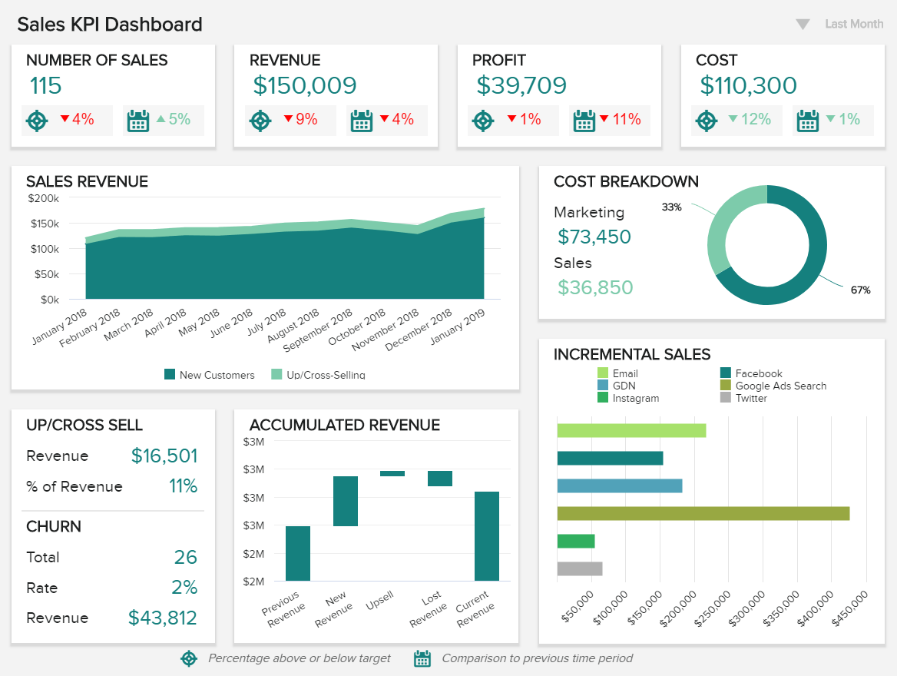

Slide 11
Thank You

